Slide 1

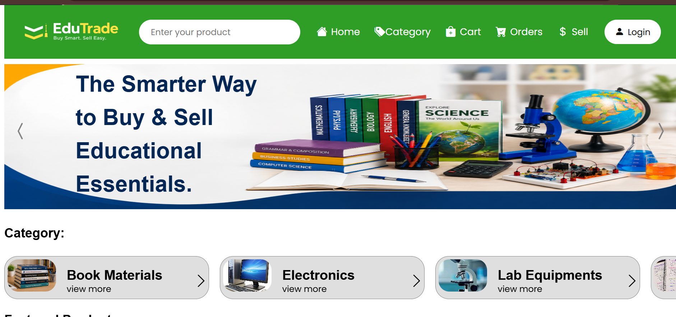
A Student E-Commerce Platform
Buy and sell books, lab equipment, electronics and more, easily and affordably.
Name: Uthaya Kumar M
Reg. No: 950523205056
Notes:
Welcome. EduTrade is a student-focused e-commerce platform where students can buy and sell books, lab equipment, electronics and other study essentials.

Slide 2



Why students need a better way
Study costs add up
Useful items go unused
No trusted platform
New textbooks, workbooks and lab kits are expensive, and most are needed for just one semester or year.
Once a course ends, books and equipment pile up at home instead of reaching someone who needs them.
General classifieds are cluttered and untrusted. Students lack a focused place to trade with each other.
EduTrade closes this gap with a student-first marketplace.
Notes:
The problem: study material is costly, reusable items are wasted, and there is no trusted student-only marketplace.

Slide 3




One marketplace, built for students
EduTrade lets students list what they no longer need and find what they do, all in one place.
Simple browsing, a clear cart and a quick sell flow keep trading easy for both sides.
Book Materials
Electronics
Textbooks, workbooks, question banks
Devices and accessories
Buy Smart. Sell Easy.
Lab Equipments
Notebooks & more
Test tubes, dissection kits
Notes and study essentials
Notes:
EduTrade focuses on categories students actually use: book materials, electronics, lab equipment and notebooks.

Slide 4






Everything you need to trade
Product search
Category browsing
Wishlist
Find any item fast from the search bar on every page.
Jump into Books, Electronics or Lab Equipments.
Save products with a tap on the heart icon.
Cart and Buy Now
Easy selling
Orders and login
Add to cart or buy instantly from any product card.
List a product with Sell New Product and manage it later.
Secure sign-in and an Orders page to follow purchases.
Notes:
Key features visible in the current website build.

Slide 5
Home: everything is one click away
1
Navigation bar
Search, Home, Category, Cart, Orders, Sell and Login in one place.
2
Hero banner
A clear message: the smarter way to buy and sell educational essentials.
3
Category cards
Quick entry to Book Materials, Electronics and Lab Equipments.
Notes:
The home page: a green navigation bar, hero banner and category cards.

Slide 6
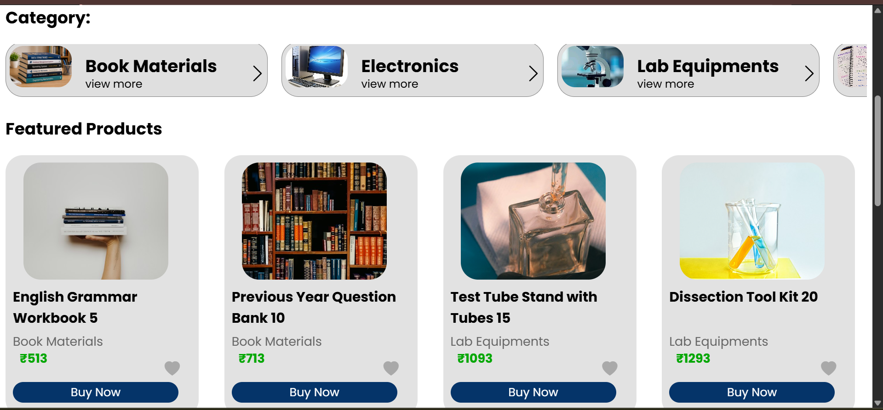
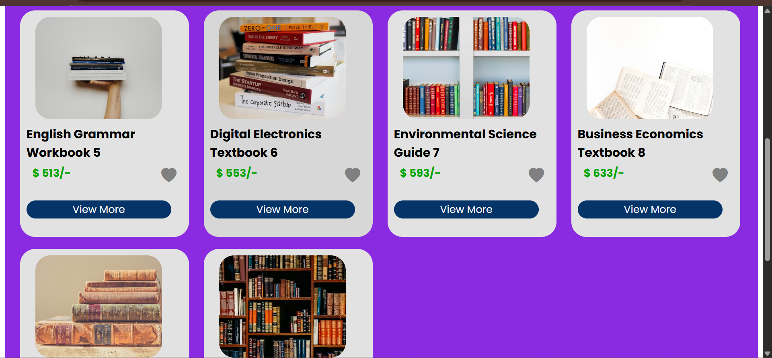
Browse categories and featured items
Featured products
Product listings
Each card shows the item, category, price in rupees, a wishlist heart and a Buy Now button.
A clean grid of titles and prices with a View More button for full details.
Notes:
Featured products and the product grid.

Slide 7
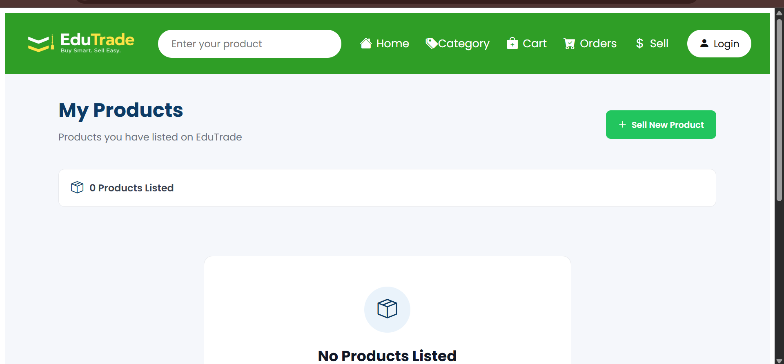
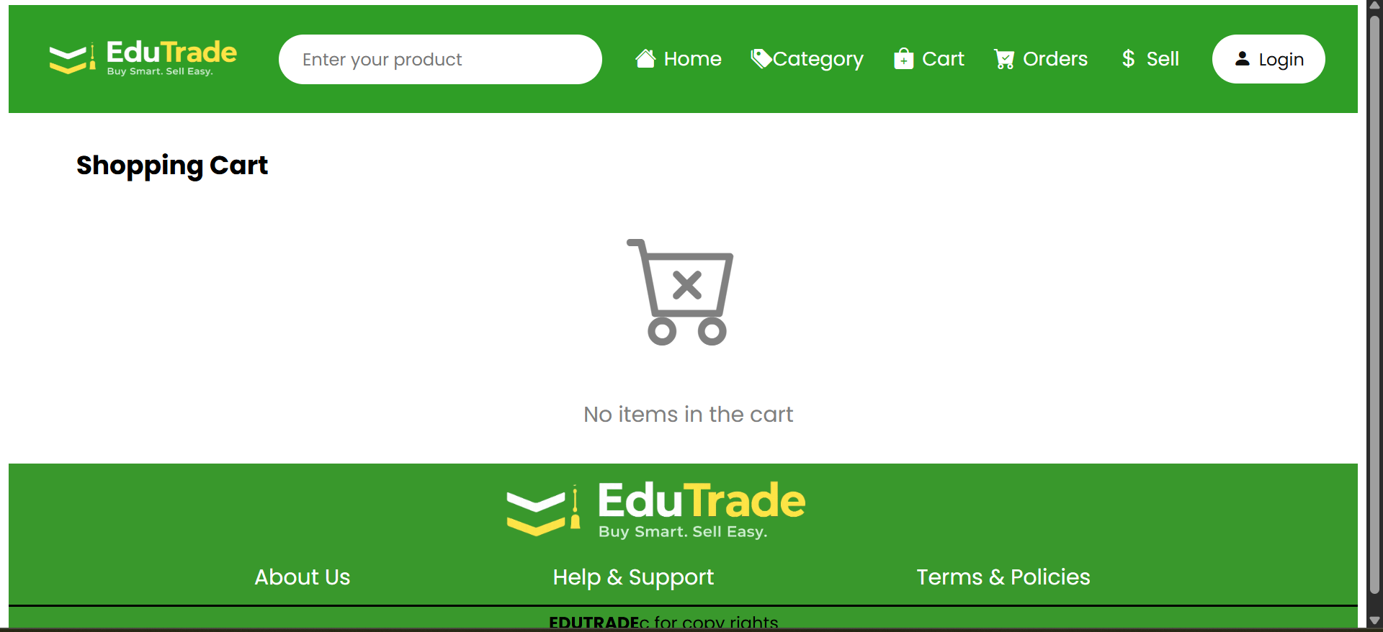
Selling and cart management
My Products
Shopping Cart
Sellers see every listing in one place and add more with Sell New Product.
Buyers review what they have picked before they check out.
Notes:
The seller dashboard (My Products) and the shopping cart.

Slide 8


How EduTrade works
1
2
3
4
Log in
Discover
Add to cart
Order
Buyer
Create an account or sign in
Search or browse by category
Wishlist it or tap Buy Now
Check out and track in Orders
1
2
3
4
Log in
List
Manage
Sell
Seller
Sign in to your account
Tap Sell and add item details
View all in My Products
Buyers find and order it
Notes:
Two simple journeys: buyers discover and order; sellers list and manage.

Slide 9



Why EduTrade works for everyone
For buyers
For sellers
Save money on study materials
Turn unused items into cash
Books, lab kits and electronics in one place
List a product in a few clicks
Wishlist and cart to compare before buying
Reach fellow students who need it
Notes:
Benefits for both sides of the marketplace.

Slide 10






What's next for EduTrade
Secure online payments
Buyer–seller chat
Integrate a payment gateway for safe checkout.
Negotiate and arrange pickup inside the app.
Ratings and reviews
Campus-based listings
Build trust with seller and product feedback.
Filter by college to exchange items locally.
Mobile app
Smart price suggestions
Android and iOS access for trading on the go.
Recommend fair resale prices from past listings.
Notes:
Planned enhancements.

Slide 11
Thank you
Questions and feedback are welcome

